Slide 1
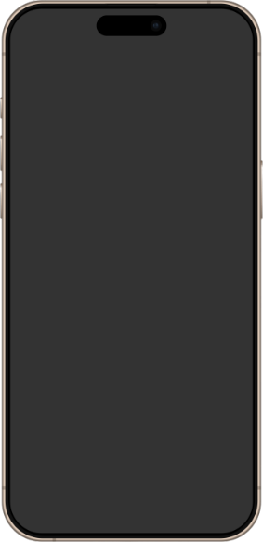


WhatsApp
Plz help me I need a professional presentation 🙏

Slide 2
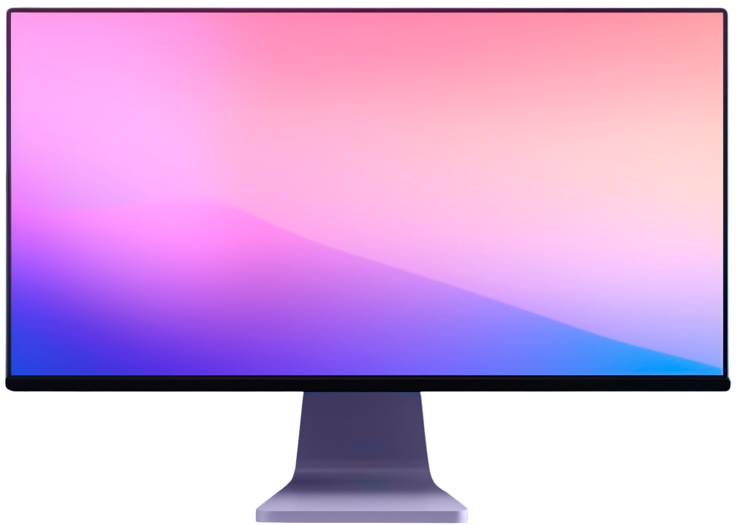
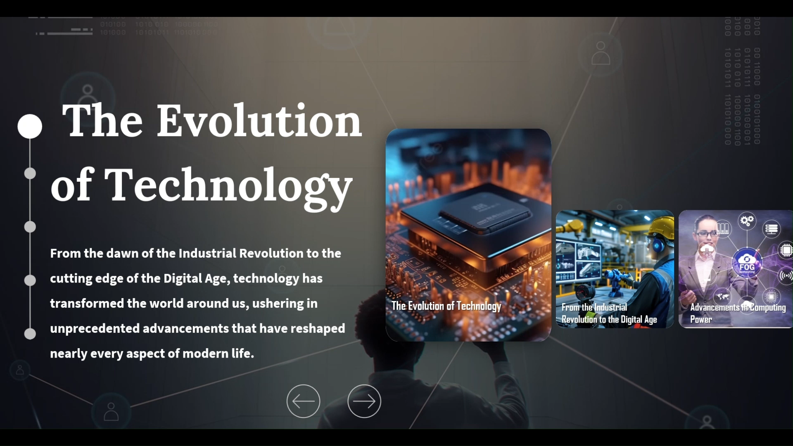
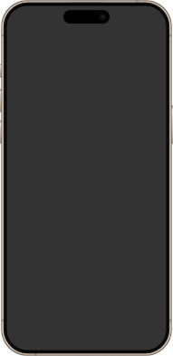
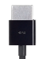

Slide 3
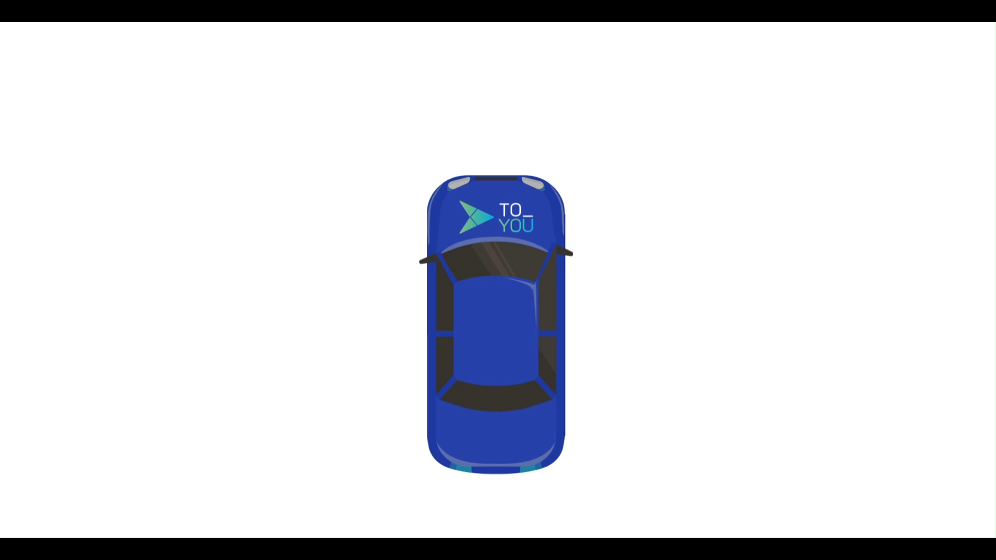

Slide 4
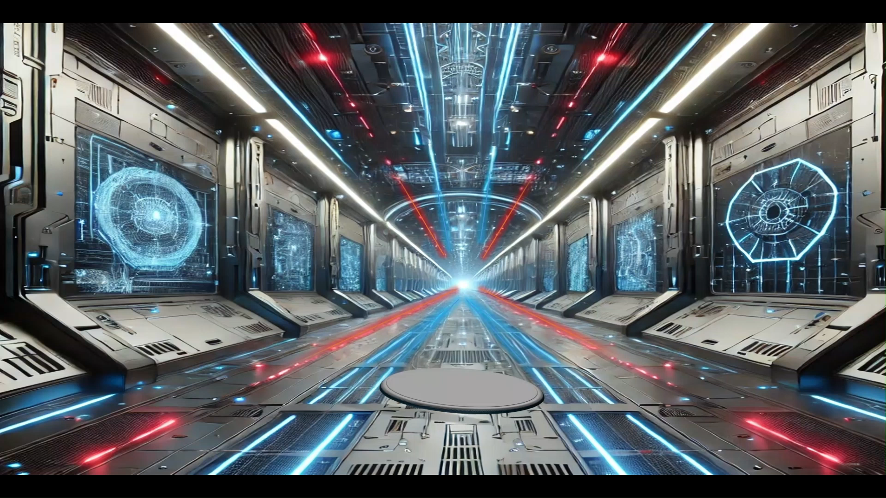

Slide 5








Ali Qayid
"Skilled in Adobe Illustrator, including designing logos, icons, and complex illustrations, as well as working with layers and typography."
"Skilled in Adobe Photoshop, including photo retouching, layer management, and creating graphics for web and print."
"Advanced proficiency in Microsoft Excel, including complex data modeling, macros, VBA programming, and dynamic dashboards for comprehensive data analysis and reporting."
"Advanced proficiency in Microsoft PowerPoint, including designing dynamic presentations with complex animations, integrating video and audio, and creating interactive slides."
Aalii07aa@gmail.com
966596433445

